Slide 1
Model of life expectancy, using GAM
Joanna Grunwald

Slide 2
Smooth function

Slide 3
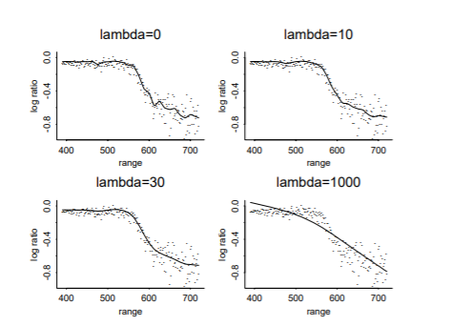

Slide 4
Smoothing parameter REML

Slide 5
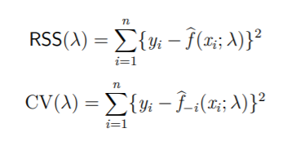
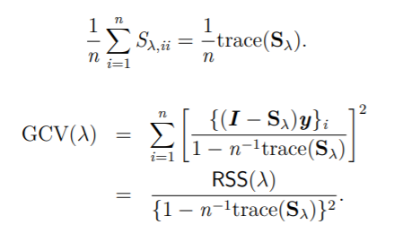
Smoothing parameter GCV

Slide 6
Data description
https://www.kaggle.com/kumarajarshi/life-expectancy-who
Dataset contain observations of life expectancy based on different countries, economic factors, social factors and many health related factors, what has been collected from the WHO data repository website and its corresponding economic data was collected from United Nation website.

Slide 7
Predictors
Status of a country
Adult mortality
Schooling
Measles
BMI
HIV
Malnutrition

Slide 8
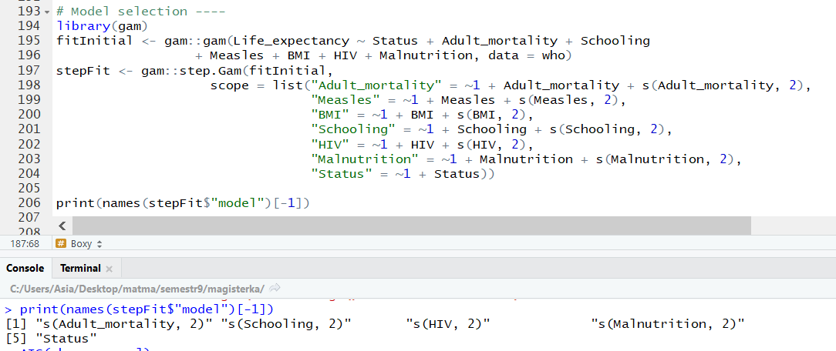
A stepwise procedure to select the form of the model

Slide 9
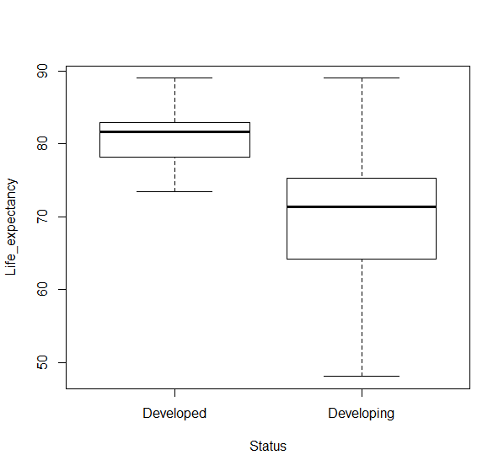

Slide 10
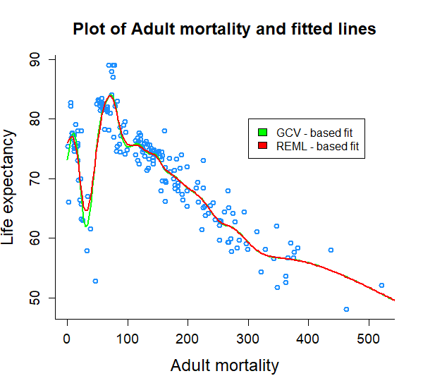

Slide 11
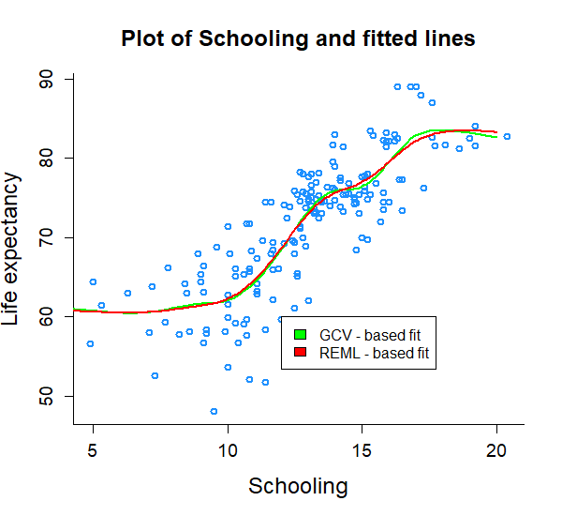

Slide 12
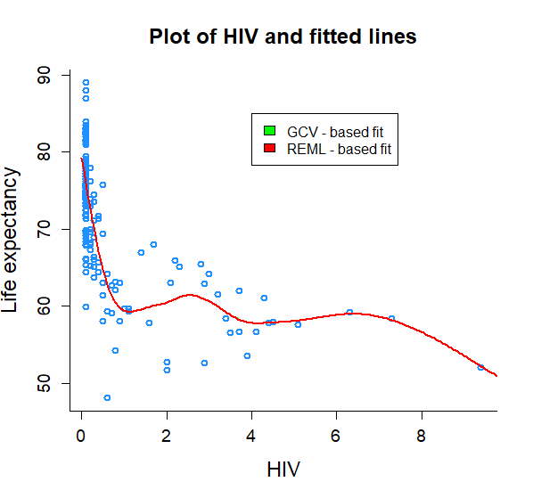

Slide 13
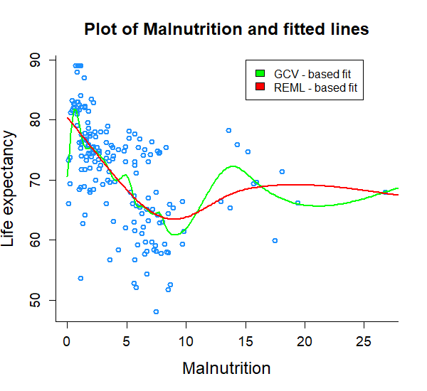

Slide 14
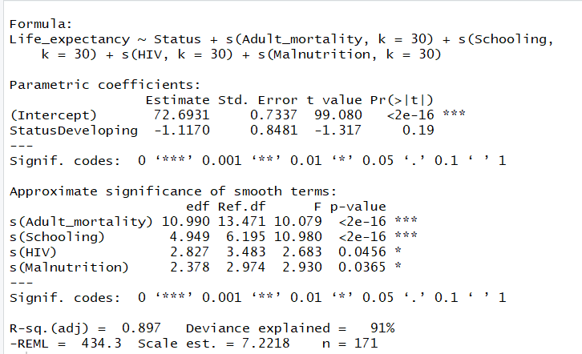
Summary of the final GAM model with REML

Slide 15
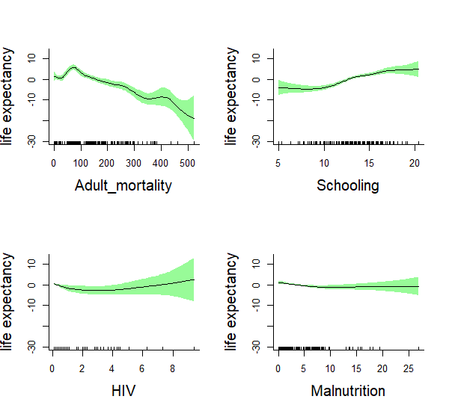
The estimated smooth functions together with their confidence intervals, REML

Slide 16
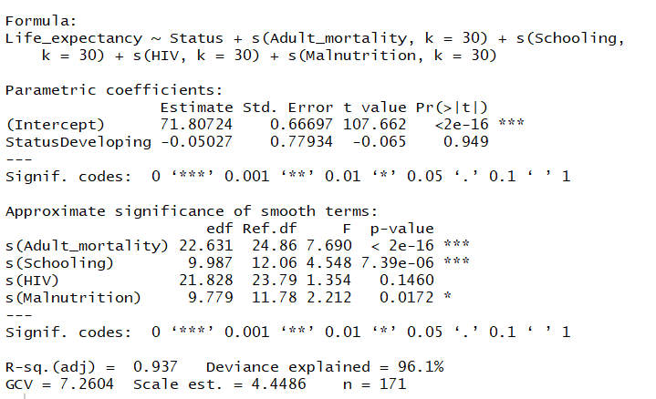
Summary of the final GAM model with GCV

Slide 17
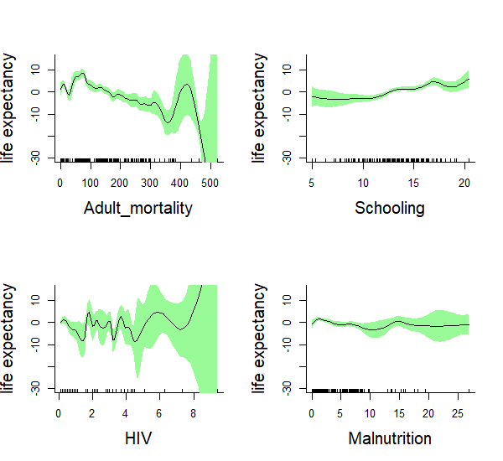
The estimated smooth functions together with their confidence intervals, GCV

Slide 18
Comparison
 | REML | GCV
AIC | 854.658 | 789.5408
BIC | 945.29 | 997.0785

Slide 19
Model | AIC | BIC
REML, k=5 | 888.5835 | 936.4584
REML, k=30 | 854.658 | 945.29
GCV, k=5 | 885.0461 | 927.3665
GCV, k=30 | 789.5408 | 997.0785

Slide 20
Model | Deviance explained
REML, k=5
REML, k=30
GCV, k=5
GCV, k=30

